Slide 1
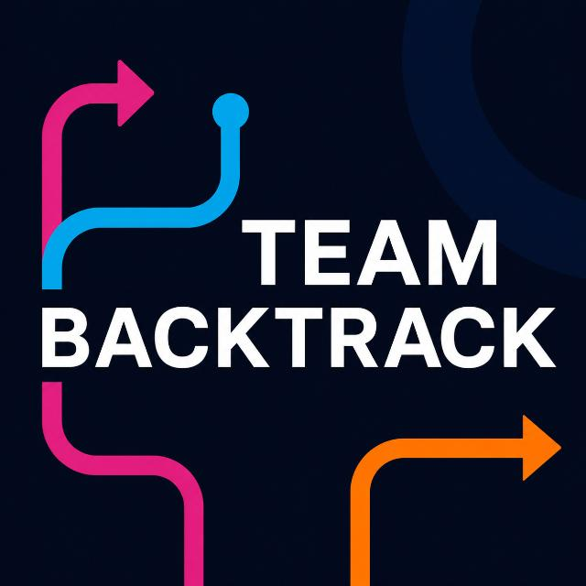
BEAUTY OF CLOUD 2.0 · FINAL ROUND
Scenario 2 — Photo & Video Social Platform on Google Cloud
BackTrack
When content goes viral, the architecture should absorb the traffic — not collapse under it.
Inusha Thathsara Gunasekara · Team Lead
Madhura Ravishan Abeywickrama
University of Moratuwa · Faculty of IT
Notes:
[~0:25] Good [morning/afternoon]. We're Team BackTrack from the University of Moratuwa, and we chose Scenario 2: a photo and video social platform on Google Cloud.
One line summarises our whole design: when content goes viral, the architecture should absorb the traffic, not collapse under it. Everything in the next fifteen minutes is about how we get there, and how much of it we actually built.
Transition: Let's start with what really breaks a social platform.

Slide 2
The problem: when one post goes viral
Storing a post is easy. Serving millions of people the same post is not.
viewers
Read-heavy traffic
1
Viewers vastly outnumber creators; every view is a read.
viewers
Massive media payloads
2
Photos and video push bytes, not rows — and spikes are unpredictable.
1 viral
post
viewers
Database write contention
3
Thousands of likes on one document hit Firestore's ~1 write/sec limit.
viewers
Real-time interactions
4
Comments and DMs must arrive without locking the primary DB.
viewers
Spiralling egress cost
5
Bandwidth, not storage, becomes the biggest bill for viral media.
illustrative
BackTrack · BOC 2.0 Final
Notes:
[~0:50] Social platforms don't fail because they can't store a post. They struggle when millions of people suddenly consume the same content.
Five things break at once: read-heavy traffic, because viewers dwarf creators; media payloads that are huge and unpredictable; database write contention, because a viral post means thousands of likes on one Firestore document, which is limited to roughly one write per second; real-time interactions that must not fight the primary database for locks; and egress bandwidth, which becomes the biggest line on the bill.
So the real challenge is not storage. It's massive unpredictable media traffic plus read-heavy load plus viral engagement plus bandwidth cost.
Transition: Our insight is that these five problems scale differently, so they should not share a path.

Slide 3
Decouple everything that scales differently
One insight, four isolated paths
1
2
3
4
Media delivery
Feed reads
Viral likes
Real-time
≠ app requests
≠ database writes
≠ persistent storage
≠ stateless containers
Signed URL → Cloud Storage → Eventarc → Cloud Run worker → CDN
Redis-cached timelines + hybrid fan-out; Firestore stays the source of truth
Redis INCR absorbs bursts; micro-batch flush to Firestore every 5 s
Redis Pub/Sub backplane connects every Cloud Run WebSocket instance
Highly decoupled · event-driven · cloud-native on Google Cloud
BackTrack · BOC 2.0 Final
Notes:
[~0:45] Here is the insight. Media delivery is not the same workload as application requests. Feed reads are not database writes. Viral likes are not persistent storage. And real-time messaging is not something stateless containers can do alone.
So we give each its own path, built from managed and serverless GCP services. Media goes straight to Cloud Storage and is processed by events. Feed reads come from Redis. Likes are absorbed by Redis counters and batched into Firestore. And WebSockets share a Redis Pub/Sub backplane.
Transition: Here is how those four paths fit together.

Slide 4
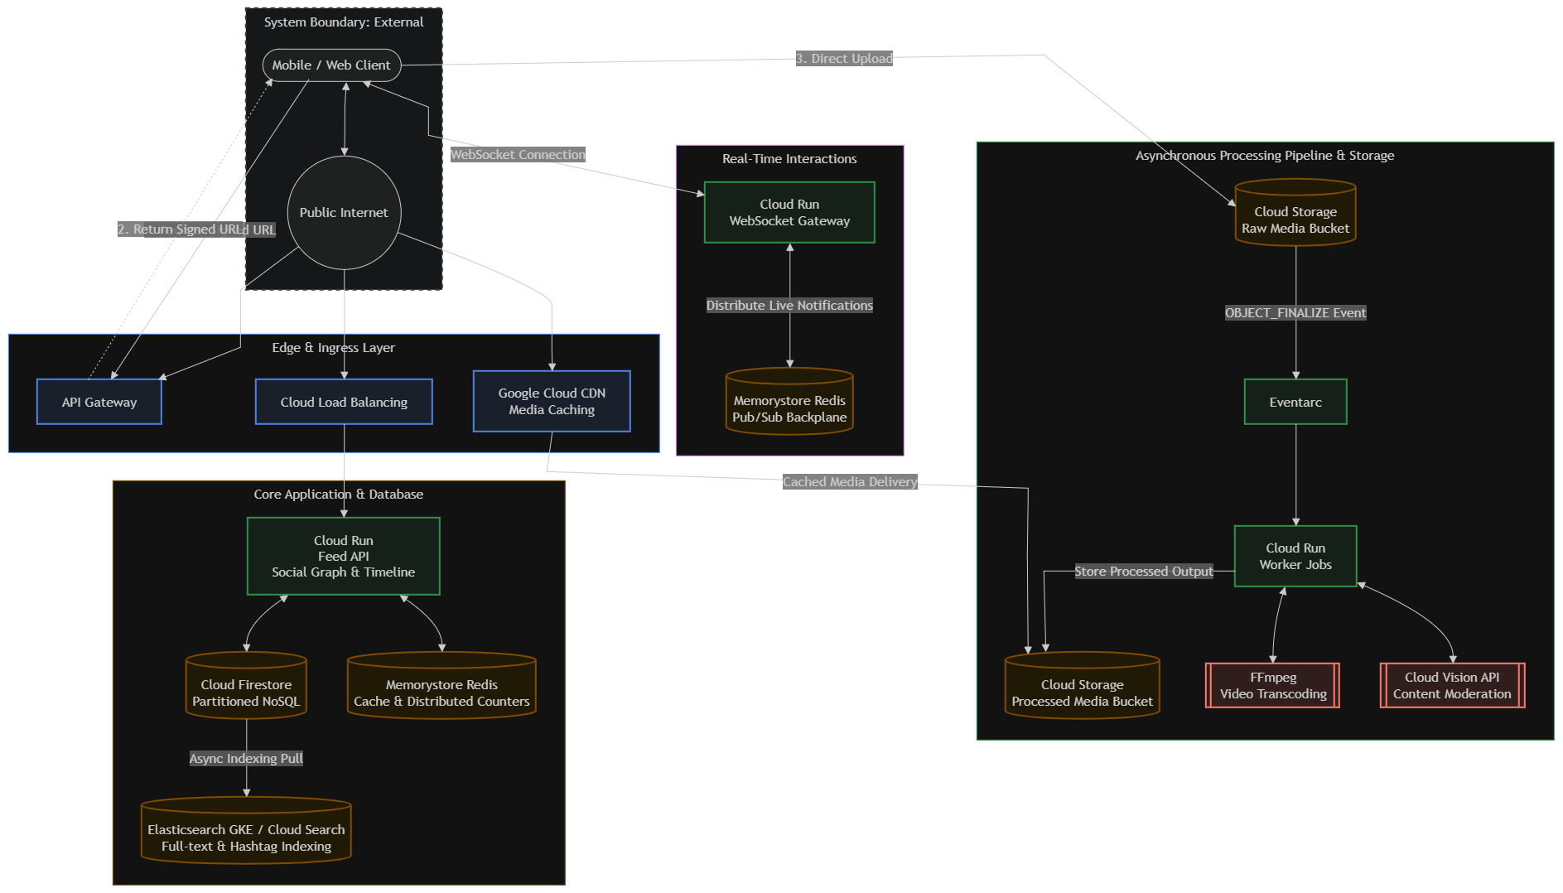
Cloud architecture
BackTrack · BOC 2.0 Final
Target architecture. CDN and Elasticsearch are not in the MVP.
Notes:
[~1:30] This is the architecture, read as five zones.
The client sits outside our boundary. It asks the API Gateway for a signed URL, then uploads straight into the private raw Cloud Storage bucket, so no media bytes touch our API. The object-finalize event goes through Eventarc to a Cloud Run worker, which runs FFmpeg for transcoding and Cloud Vision for moderation, then stores the output in the processed bucket.
The Core Application zone is the Feed API on Cloud Run, with Redis for cache and distributed counters and Firestore as the source of truth. Real-time interactions run through a Cloud Run WebSocket gateway with a Redis Pub/Sub backplane. The Edge layer fronts everything.
Be explicit: Cloud CDN and Elasticsearch are part of the target architecture but not built in our MVP. The status slide covers that.
Transition: Now, why each of these services.

Slide 5
Why these GCP services?
Service → problem → reason
Cloud Storage
Cloud CDN
Cloud Run
Eventarc / Pub/Sub
Problem Uploads must not consume API compute
Problem Repeat global reads create origin load + egress
Problem Traffic is unpredictable and can go viral
Problem Processing must not block user requests
Why Direct signed-URL upload keeps payloads off servers
Why Edge caching serves hot media near users
Why Serverless containers: auto-scale, scale to zero
Why Async events give decoupling and retries
Memorystore Redis
Firestore
Cloud Vision
Elasticsearch
Problem Feeds and real-time hammer the DB
Problem Need durable app data without servers to run
Problem Manual moderation does not scale
Problem Firestore can't do fuzzy full-text search
Why In-memory cache, counters and Pub/Sub backplane
Why Managed NoSQL that scales with the platform
Why Automated SafeSearch on every upload
Why Dedicated index for hashtag / user discovery
BackTrack · BOC 2.0 Final
Notes:
[~0:50] Don't read the cards; pick three.
Cloud Run, because viral traffic is unpredictable and we want horizontal scaling plus scale-to-zero so we don't pay for idle. Redis, because feed reads and real-time messaging would otherwise crush the database, and Firestore can't take viral write bursts on its own. And direct-to-Cloud-Storage uploads, because media is the heaviest payload and shouldn't flow through application servers at all.
Each service answers one specific problem from the earlier slide.
Transition: The next slide is the most interesting technically: how we survive a viral spike.

Slide 6
Designed for viral scale
Two patterns keep reads and writes from colliding
Hybrid feed fan-out
FUTURE
Distributed counters
IMPLEMENTED
Normal user posts
Push post ID into follower Redis timelines
Naive
write once per follower — fine at normal scale
1 like = 1 Firestore write → ~1 write/s ceiling → throttling
Celebrity posts
✕
No fan-out to millions of lists
BackTrack
1000s of likes
Redis INCR (atomic)
Batch to Firestore
At read time: merge celebrity posts into the cached timeline
Trade-off: counts are eventually consistent for up to ~5 s.
MVP today: read-time heuristic ranking over all posts; celebrity flag only boosts score.
Code: INCRBY + 5 s flush timer in the Feed API.
BackTrack · BOC 2.0 Final
Notes:
[~1:30] Two patterns make the design viral-proof.
First, hybrid fan-out. For a normal user, when they post we push the post ID into their followers' cached timelines. For a celebrity with millions of followers that would be a write storm, so we don't. Celebrity posts are merged at read time instead. Being honest: in our MVP this is architecture-level. The MVP ranks posts at read time with a heuristic and only boosts celebrity accounts in the score. The fan-out timelines are future work.
Second, distributed counters, which we did build. A naive design writes every like to Firestore, which caps at about one write per second per document. We do an atomic Redis INCR and flush accumulated deltas to Firestore in a batch every five seconds. The trade-off is that counts are eventually consistent for a few seconds, which is perfectly acceptable for likes.
Transition: Next, how we keep all of this trustworthy.

Slide 7
Secure by design
Defence in layers — and what is real today
Identity
OAuth 2.0 / OIDC sign-in
MVP uses demo personas + unverified token decode — real verification is next
MOCKED
Access
Least-privilege IAM service accounts per service
Terraform defines separate accounts for API, worker, Eventarc
PARTIAL
Upload
Private buckets; single-use V4 signed URLs, 15-min TTL
Signed-URL route in Feed API; falls back to mock without GCS credentials
PARTIAL
Data
AES-256 at rest (Google-managed) · TLS 1.3 in transit
Platform defaults on GCP — not custom-built
IMPLEMENTED
Messages
DMs readable only by sender and recipient
Firestore security rules written in infra/firestore.rules
IMPLEMENTED
App edge
Rate limits, Helmet headers, non-root containers
120 req/min API · 20 uploads/min · USER node
IMPLEMENTED
Design: worker must not read user profiles. MVP Terraform gives it broader Firestore access (to update post status); we would tighten this.
BackTrack · BOC 2.0 Final
Notes:
[~0:55] Security as layers, with honest status on each.
Uploads: private buckets and single-use signed URLs with a fifteen-minute lifetime, so clients never get standing write access. Data is encrypted with AES-256 at rest and TLS in transit, which are GCP platform defaults. DMs are protected by Firestore rules so only the sender and recipient can read them. The API has rate limiting, hardened headers, and containers run as non-root.
Where we're not there yet: identity. The MVP uses demo personas and a token decoder that does not verify signatures. Production would use OAuth/OIDC with real verification. Also, our design says the transcoding worker should be denied user-profile access; in the Terraform today it holds a broader Firestore role so it can update post status. We know, and we'd tighten it with a narrower custom role.
Transition: Reliability and monitoring.

Slide 8
Reliable & observable
Prefer availability and no data loss over exotic complexity
Redis fails
PARTIAL
Metric → threshold → action
Feed API falls back — slower feed, platform stays online
Metric | Target | Action
CDN cache hit ratio | ≥ 85% | Alert: origin egress is spiking
P99 feed latency | < 200 ms | Trace via Cloud Trace; scale / tune cache
DLQ depth | ≈ 0 | Spike = media pipeline failing; page on-call
Code falls back to in-memory / Firestore; circuit breaker not built
Processing fails
FUTURE
Failed events retried with exponential backoff via Pub/Sub dead-letter queue
MVP uses a direct Eventarc → Cloud Run push; no DLQ yet
Zone outage
FUTURE
Multi-AZ inside one region — not multi-region
Cloud Run is regional by default; Redis HA is optional/off in MVP
Principle: brief latency is tolerable. Lost uploads or an unavailable feed are not.
Targets, not measured results. MVP today: structured JSON logs (Cloud Logging); dashboards and alerts are future.
BackTrack · BOC 2.0 Final
Notes:
[~1:00] Our reliability philosophy: a consumer social app can tolerate a slow feed for a moment, but not lost uploads or an unavailable feed.
If Redis fails, the Feed API falls back to Firestore: slower, still online. In our MVP, the code does fall back when Redis is absent, but the circuit-breaker pattern is not built. If processing fails, the design retries with exponential backoff through a Pub/Sub dead-letter queue, so media is never silently lost; our MVP uses a direct Eventarc push without a DLQ yet. We chose multi-AZ within a region rather than expensive multi-region.
Monitoring is metric, threshold, action: CDN hit ratio of at least eighty-five percent, P99 feed latency under two hundred milliseconds, and DLQ depth near zero. These are targets, not measurements. Today we have structured logs; dashboards and alerts are future.
Transition: And what does this cost?

Slide 9
Cost-aware: the cost of performance
Estimated architecture-level operating cost — not the MVP's cost
How we keep it down
Serverless + scale to zero
Cloud Run pays only for use (MVP: min instances 0)
CDN + cache hits
Keeps most traffic off the origin and its egress fees
Lifecycle policies
Nearline after 30 days, Archive after 180 days
Async + cache
Fewer DB reads and writes; no blocking work
$670 – $1,230 / month architecture estimate at scale
MVP itself targets the GCP Always Free tier ($0), with free-tier switches for Redis and load balancer.
BackTrack · BOC 2.0 Final
Notes:
[~0:45] The message here: we optimise not only for performance, but for the cost of performance.
The estimate at scale is roughly six hundred seventy to twelve hundred thirty dollars a month. To be clear, this is an architecture-level estimate for the full design, not what our MVP costs. The MVP is configured for the GCP always-free tier with switches for the paid pieces like Memorystore.
The levers: serverless compute that scales to zero, CDN caching so most traffic never reaches the origin, lifecycle policies that move processed media to Nearline after thirty days and Archive after one hundred eighty, and asynchronous processing with caching to cut database operations.
Transition: Now to the part that matters most: what actually runs.

Slide 10
From architecture to working MVP
Honest status, verified against the repository
Capability | Status | Evidence
React PWA: feed, stories, DMs, upload UI | ● IMPLEMENTED | web/ · screenshots
Feed API (Cloud Run) with heuristic ranking | ● IMPLEMENTED | feed-api/ranking.ts
Redis INCR counters + 5 s Firestore flush | ● IMPLEMENTED | redis.ts (in-memory fallback)
WebSocket gateway + Redis Pub/Sub backplane | ● IMPLEMENTED | websocket-gateway · DM screenshot
24 h ephemeral stories | ● IMPLEMENTED | stories route · lifecycle rule
Direct-to-GCS V4 signed URL (15 min) | ● PARTIAL | media.ts; UI uses sample URL
Eventarc → worker: FFmpeg HLS + Vision | ● PARTIAL | worker code + Terraform; fallbacks
Firestore persistence | ● PARTIAL | client + in-memory seed fallback
HLS playback demo stream | ● MOCKED | public test stream when no transcode
Auth: OAuth 2.0 / OIDC | ● MOCKED | persona switcher, unverified JWT
Cloud CDN · Elasticsearch · Pub/Sub DLQ | ● FUTURE | not in repo
Hybrid fan-out · monitoring alerts · Vertex AI | ● FUTURE | not in repo
BackTrack · BOC 2.0 Final
Notes:
[~0:55] Transparency slide. We separate the architecture vision from what runs today.
Green, implemented: the React web client, the Feed API on Cloud Run with a heuristic ranking formula, Redis atomic counters with five-second Firestore flush, the WebSocket gateway with a Redis Pub/Sub backplane, and ephemeral stories.
Amber, partial: the signed-URL route exists, but our demo upload dialog submits a sample URL; the Eventarc-to-worker pipeline has code and Terraform, with fallbacks; Firestore is wired in with an in-memory fallback so we can demo offline.
Blue, mocked: the HLS playback in our demo uses a public test stream, and authentication is a persona switcher.
White, future: Cloud CDN, Elasticsearch, the DLQ, hybrid fan-out timelines, alerting, and Vertex AI.
Transition: Let's see it.

Slide 11
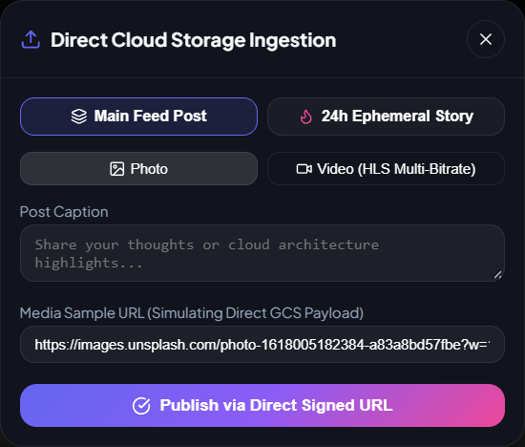
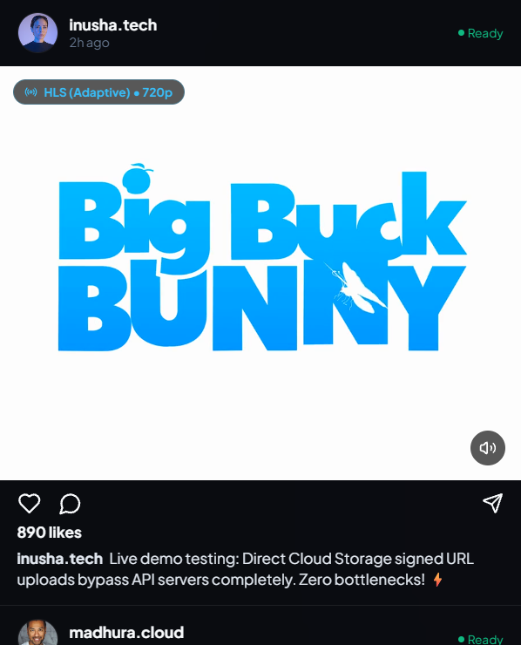
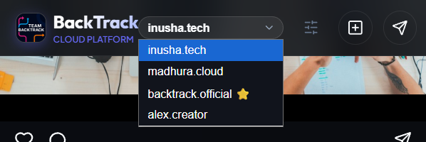
Live MVP demo: upload → processing → feed
1 Open feed
2 Pick persona
3 Upload via signed URL
4 Status: Ready
5 Appears in feed
Persona switcher (demo identity)
Live: pick a persona, publish, watch status turn Ready.
Open live MVP ↗
Ingestion dialog: post or 24 h story, via signed URL
HLS badge; demo uses a public test stream
BackTrack · BOC 2.0 Final
Notes:
[~1:15] Now the demo. [Switch to the live app. If the network misbehaves, play the recorded run.]
Step one, the feed: stories at the top, and a ranked For You timeline. Step two, the dropdown lets us act as different users; that's our demo identity, not real auth. Step three, the plus button opens Direct Cloud Storage Ingestion: choose a main post or a twenty-four-hour story, photo or video, add a caption, and publish through a signed URL. In this build the dialog pre-fills a sample media URL to simulate the direct payload, so we're showing the flow, not a real file transfer from this screen. Step four, posts carry a status chip, Ready here. Step five, the post is in the feed; the HLS badge marks video served as an adaptive stream, which in the demo is a public test stream.
Be explicit about scope: fully built, the feed and ranking and UI; partial, signed upload and worker; mocked, the HLS source and identity.
Transition: Now the real-time half.

Slide 12
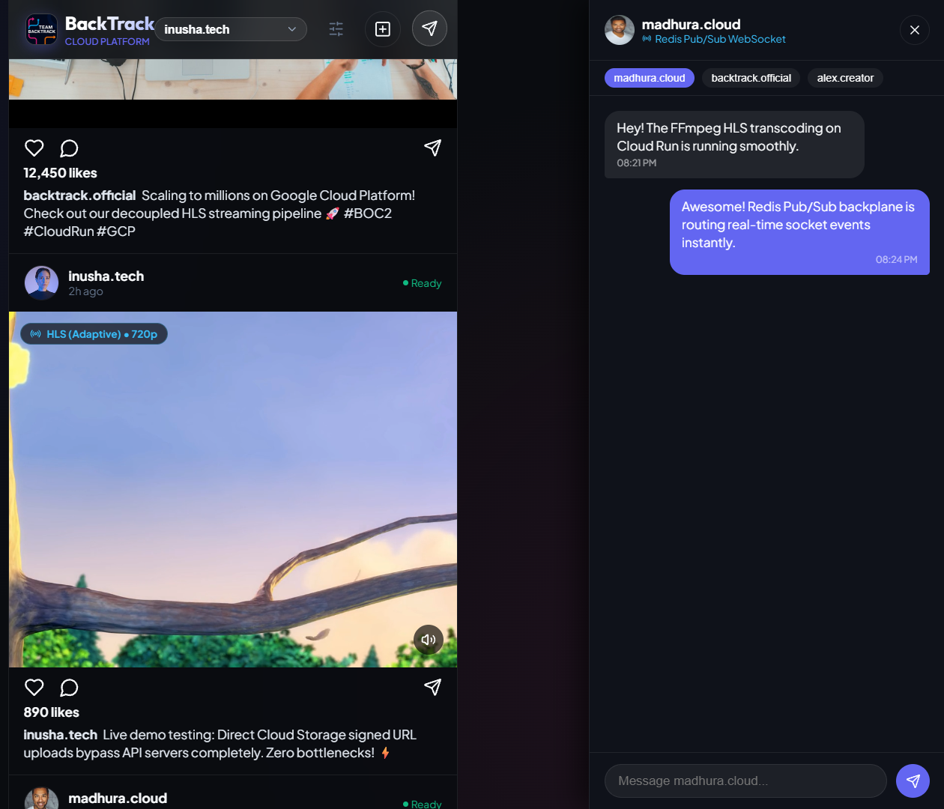
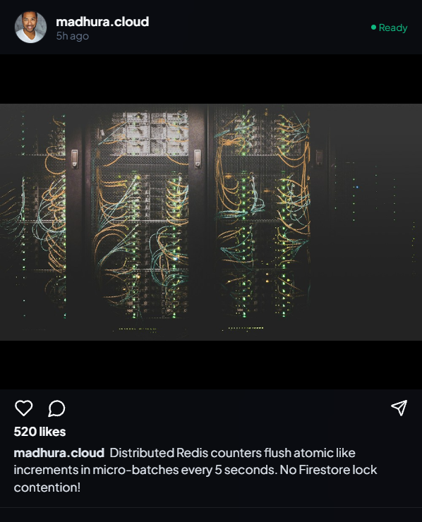
Live MVP demo: real-time & engagement
Real-time DMs
Live chat over WebSocket; Redis Pub/Sub fans messages across instances.
Likes
Redis INCR, batched to Firestore (code path; show live).
Post status
Posts show Ready once processing completes.
BackTrack · BOC 2.0 Final
Notes:
[~0:50] The real-time half. Here two users chat. The panel is labelled Redis Pub/Sub WebSocket. Each message goes to a WebSocket gateway on Cloud Run, is published to Redis, and every gateway instance subscribed to that channel delivers it, so the recipient gets it no matter which container they're connected to. That's the whole reason for the backplane: Cloud Run containers are ephemeral and stateless.
On the engagement side, a like increments a Redis counter atomically and the delta is flushed to Firestore in the next five-second batch. Back in the feed, every post carries a Ready status once processing is done.
Transition: Building this taught us a few things.

Slide 13
Engineering challenges & lessons
Problem → decision → learning
PROBLEM
DECISION
LEARNING
Viral likes vs Firestore write limit
Redis INCRBY + 5 s micro-batch flush
Trade consistency for throughput; stats can lag a few seconds
Real-time across ephemeral Cloud Run
Redis Pub/Sub backplane; 30 s heartbeat; session affinity
Stateless containers need external state; idle sockets get cut at ~60 s
Heavy media vs the API
Signed-URL direct upload; event-driven worker; /tmp cleanup
Event-driven pipelines need cleanup and fallbacks, not just happy paths
Ambition vs credits and time
Free-tier switches, in-memory fallbacks, 19-step e2e test (reported)
Be explicit about mocked vs real; a smaller honest MVP beats a faked one
BackTrack · BOC 2.0 Final
Notes:
[~0:45] Four real challenges.
Viral likes versus the Firestore write limit: we chose Redis counters with a five-second flush, and learned that we're trading a little consistency for a lot of throughput.
Real-time on ephemeral Cloud Run: a Redis Pub/Sub backplane, plus a heartbeat because idle WebSockets get cut around sixty seconds. Lesson: stateless containers need state somewhere else.
Heavy media: signed URLs and an event-driven worker, and we learned to clean the worker's temp disk, because Cloud Run's disk is in memory.
And the meta-challenge, ambition versus time and credits. We built free-tier switches and fallbacks, and chose to label mocked parts honestly. The repository README reports a nineteen-step end-to-end test passing.
Transition: What comes next.

Slide 14
Roadmap & future scale
1
2
3
Now: MVP
Phase 2: close the gaps
Phase 3: smarter, faster
Feed, ranking, counters, WebSockets, stories, signed-URL route, worker code, Terraform + CI
Cloud CDN · Pub/Sub DLQ + retries · Elasticsearch · real OIDC verification · alerts & dashboards · hybrid fan-out timelines · multi-bitrate HLS ladder + DASH
Vertex AI personalised feed ranking · predictive prefetch of the next video's first seconds · multi-region DR if scale demands
Vertex AI ranking and predictive prefetching are the two improvements named in our proposal.
BackTrack · BOC 2.0 Final
Notes:
[~0:30] Where we go next. The MVP is our foundation. Phase two closes the architecture gaps we flagged: CDN, dead-letter queue, Elasticsearch, real OIDC verification, alerting, hybrid fan-out, and a proper multi-bitrate ladder. Phase three is what our proposal calls out as future: Vertex AI for personalised ranking, replacing our heuristic, and predictive prefetching so the next video starts instantly.
Transition: To close.

Slide 15
BackTrack turns viral traffic from a threat into a workload the system is designed to absorb.
Viral scale
Decoupled media
Low-latency delivery
Security & fault tolerance
Cost efficiency
Cloud-native by design. Honest about the MVP.
Thank you · Q&A
Try the live MVP ↗
Inusha Thathsara Gunasekara · Madhura Ravishan Abeywickrama
backtrack-web-894866134623.us-central1.run.app
Team BackTrack · University of Moratuwa
Notes:
[~0:30] To close. BackTrack is not just a social-media prototype. It's an architecture built around viral scalability, decoupled media processing, low-latency delivery, security, fault tolerance and cost efficiency, and we've shown the parts that run and been straight about the parts that don't yet.
Our key idea is simple: when content goes viral, the architecture should absorb the traffic, not collapse under it. Thank you. We're happy to take questions.
Total speaking time across slides is about thirteen minutes fifteen seconds, leaving a buffer of one to two minutes.

